Slide 1

Olympics – Growth segment for Athletes over 30 years old
Capstone Final
Sheila Lynch
October 21, 2018

Slide 2
As I watch the Olympics this past year and listening the the athlete's stories, most are young adults competing in the variety of sports. It raised the question, how many athletes are over 30 years old. And how many of those over 30 years old earn a medal. And while this information is good for trivia answers, I am validating as manufactures of these sports focus on specific age groups to market product and is there a market for athletes over 30.

Slide 3
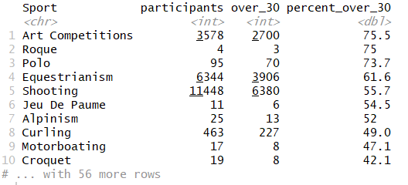
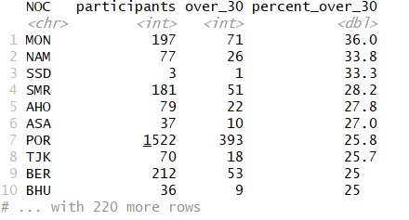
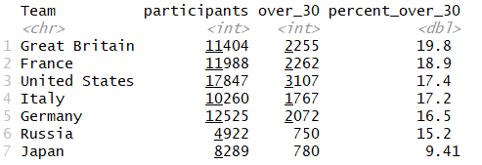
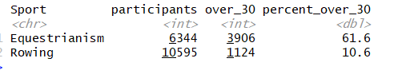
The Data
The dataset is historical Olympic results since 1900 to 2016 with Age, Sport, Country and Medals.
Evaluated the percentages of highest proportion of athletes over 30 establishing the baseline for all athlete events.
1. Proportion of Sports (Equestrianism is number 4
2. Proportion of Country – top 3 are small considering participant totals. So second review was of the top 7 participating Teams which have 19-20% over age 30 participants.
3. Proportion of target Sport

Slide 4
Overall the highest proportion of athletes over 30 in all of the events/time have the top 5 being over 65 years ago. And finally lets consider the proportion of the participants that earned medal over age 30 in the last 20 years, which in 2016 was 2.6% compared to 2008 it was 2.5%, not much change. It was 1920 that had the highest percentage of 11.7%.
And let’s consider the mean age:
All Athletes over full timeline – 25.5 years old
All Athletes over timeline of top 7 Teams – 25.9 years old
All Equestrian Athletes – 34.1 years old
All Rowing Athletes – 25.3 years old
Year | Medaled | Total Participants | Over_30 | percent_over_30 | Percent over 30 win medal
2016 | No | 11665 | 2148 | 18.4
2016 | Yes | 2023 | 350 | 17.3 | 3%
2014 | No | 4294 | 715 | 16.7
2014 | Yes | 597 | 107 | 17.9 | 2%
2012 | No | 10979 | 1926 | 17.5
2012 | Yes | 1941 | 298 | 15.4 | 2%
2010 | No | 3882 | 754 | 19.4
2010 | Yes | 520 | 116 | 22.3 | 3%
2008 | No | 11554 | 1995 | 17.3
2008 | Yes | 2048 | 343 | 16.7 | 3%
Year | Medaled | Total Participants | Over_30 | percent_over_30 | Percent over 30 win medal
1920 | No | 2984 | 836 | 28
1920 | Yes | 1308 | 466 | 35.6 | 11%
1948 | No | 6493 | 1771 | 27.3
1948 | Yes | 987 | 264 | 26.7 | 4%

Slide 5
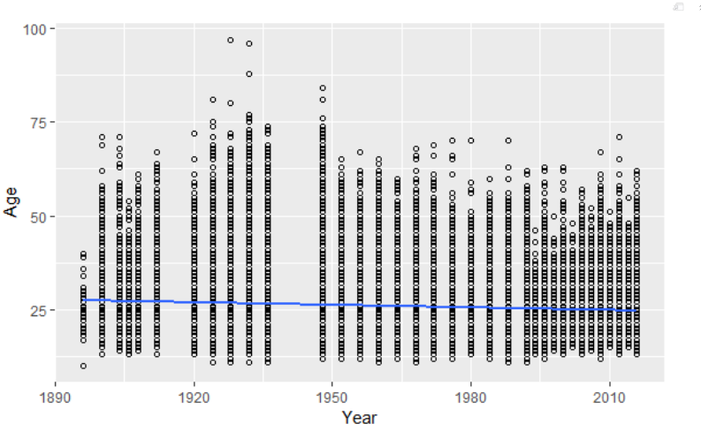
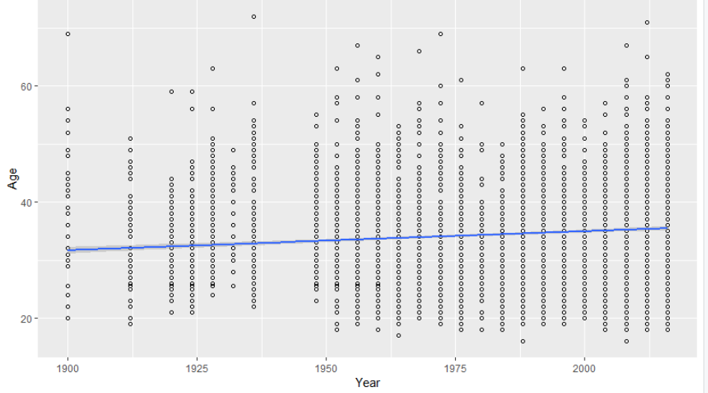
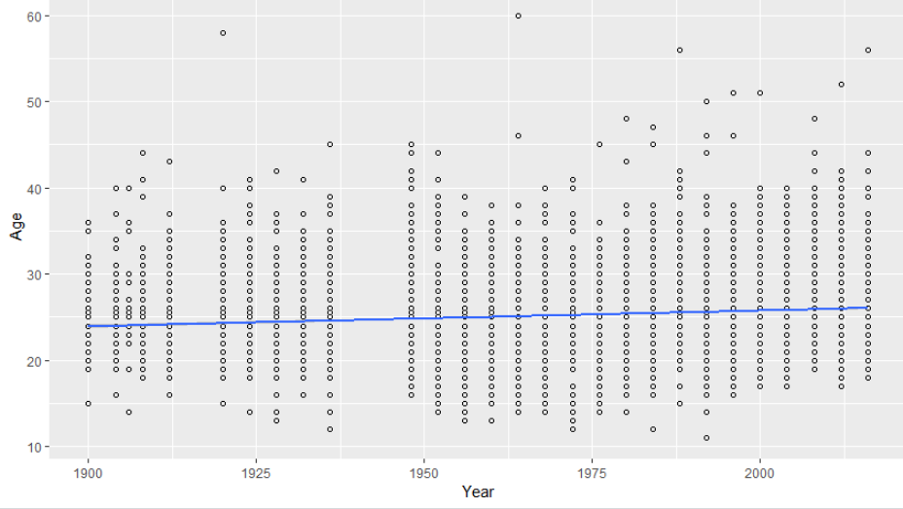
What does the current data trends show?
Let’s consider the current trends for all Sports, Equestrianism and Rowing. While overall age is declining it is increasing in Rowing and Equestrianism.
All Sports
Equestrianism
Rowing

Slide 6
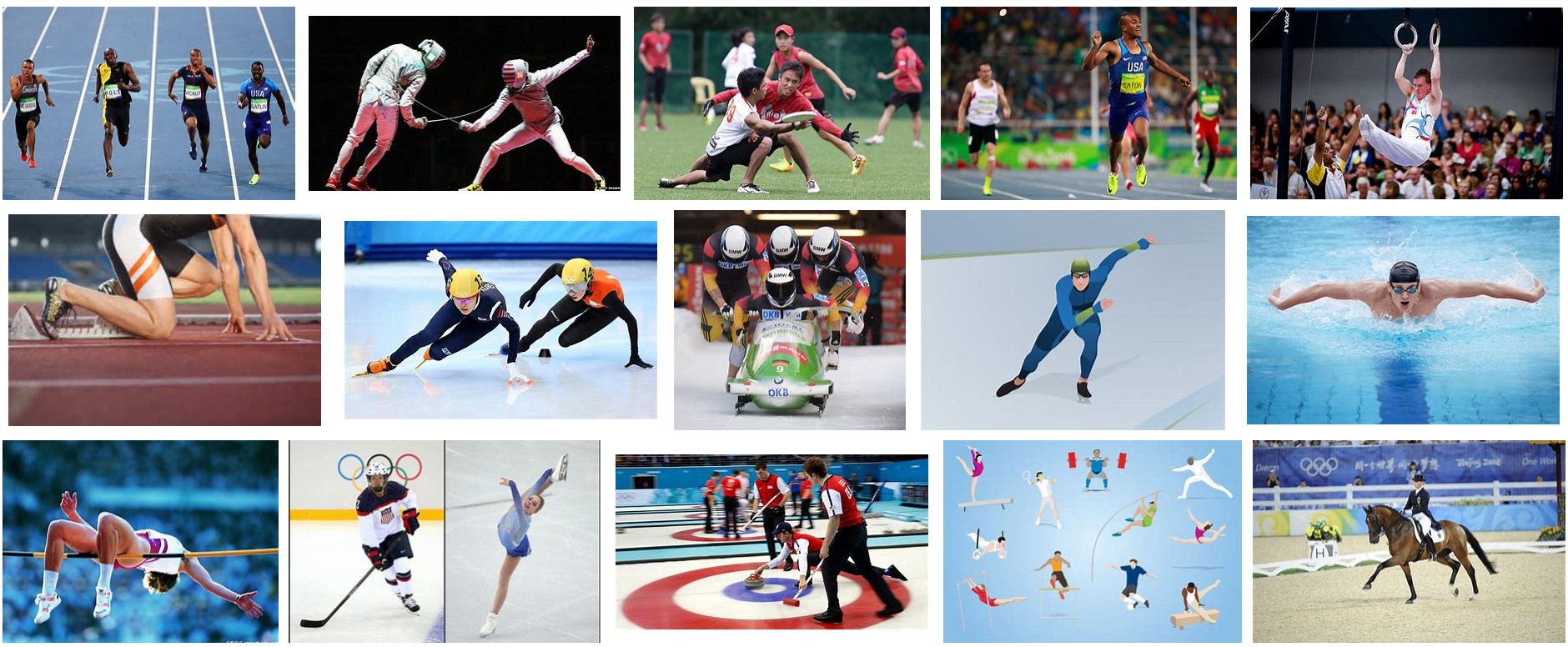
Ultimately I would like to know if I am looking to earn a medal and over age 30 which sport should I choose. I am now going to compare these two sports, each of which have a higher mean age and discover if this mean has increased over the years. I need to run analysis on each sport and if the mean age has changed. And does the higher mean age increase or decrease the probability of those athletes over 30 earning a medal.
This trend would not only provide more opportunities to older athletes, but also to those companies that market to athletes on the different needs. This would open a growth segment in their marketing to these athletes.

Slide 7
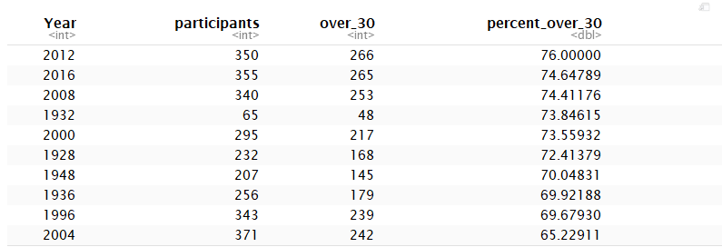
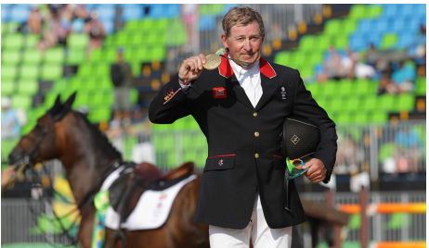
Let’s look at the proportions for Equestrianism
Considering participation over the years, the top 3 are in the year 2000+.
The result of earning a medal being over age 30
2016 was 9.9% compared to 2008 was 12.1% and 12.5% in 2000 .
This reflects while mean age has increased, it does not equally increase in earning medal
However it is vastly higher than the results in overall events of 2.5% so participation in Equestrianism does suggest a higher opportunity to win a medal for those participants over 30 years old.
Year | Medaled | Total Participants | Over_30 | percent_over_30 | Percent over 30 win medal
2016 | No | 310 | 230 | 74.2
2016 | Yes | 45 | 35 | 77.8 | 10%
2012 | No | 305 | 238 | 78
2012 | Yes | 45 | 28 | 62.2 | 8%
2008 | No | 295 | 212 | 71.9
2008 | Yes | 45 | 41 | 91.1 | 12%
2004 | No | 324 | 205 | 63.3
2004 | Yes | 47 | 37 | 78.7 | 10%
2000 | No | 250 | 180 | 72
2000 | Yes | 45 | 37 | 82.2 | 13%

Slide 8
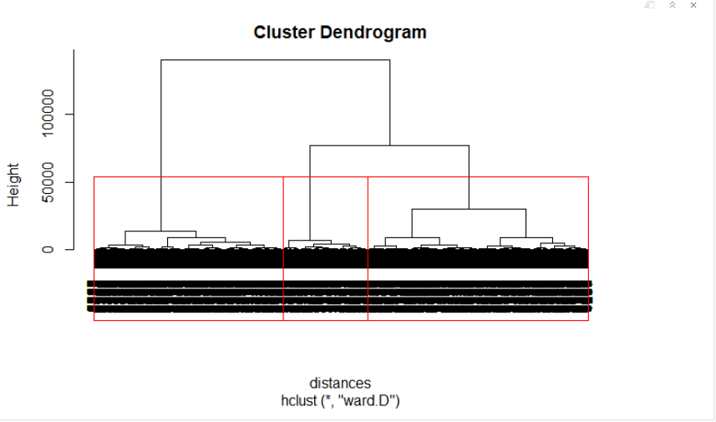
Linear Regression for Training set of Equestrianism
Upon initial results, the R square was under 1% considering Age to dependent variable Medal Value.
Then changing the fixed variable to Age over 30 and adding to the dependent variable NOC and Age the R squared improved to 53.8%.
The cluster dendrogram moves into 3 main clusters, however there is too much variation on age and earning a medal to make an accurate prediction.

Slide 9
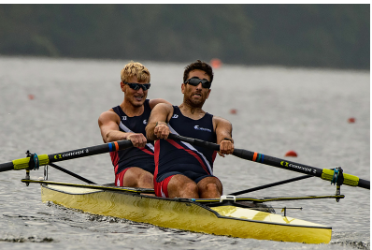
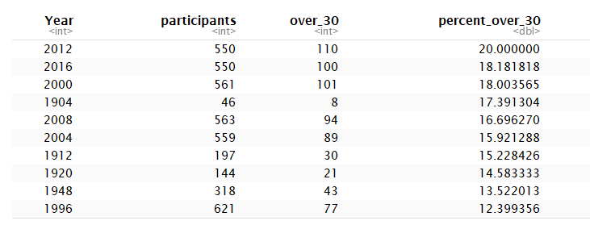
Moving to the Test dataset – Rowing. Will the mean age increase and is there a opportunity to earn a medal for this group.
Let’s start with the proportion of participants over 30
The proportion of participants in Rowing shows the trend increasing as the highest participation percentage has happened in the year 2000+. 1. For those over 30 earning medals, the result in 2016 was 6.7% compared to 2008 in which it was 7.1% and 5.3% in 2000.
2. This shows since year 2000, there has been an increase in those over 30 earning a medal in Rowing.
3. It is substantially higher than the results in overall events of 2.5% so participation in Rowing does suggest a higher opportunity to win a medal for those participants over 30 years old, though perhaps not as high as Equestrianism.
Year | Medaled | Total Participants | Over_30 | percent_over_30 | Percent over 30 win medal
2016 | No | 406 | 63 | 15.5
2016 | Yes | 144 | 37 | 25.7 | 7%
2012 | No | 406 | 81 | 20
2012 | Yes | 144 | 29 | 20.1 | 5%
2008 | No | 419 | 54 | 12.9
2008 | Yes | 144 | 40 | 27.8 | 7%
2004 | No | 415 | 55 | 13.3
2004 | Yes | 144 | 34 | 23.6 | 6%
2000 | No | 417 | 71 | 17
2000 | Yes | 144 | 30 | 20.8 | 5%

Slide 10
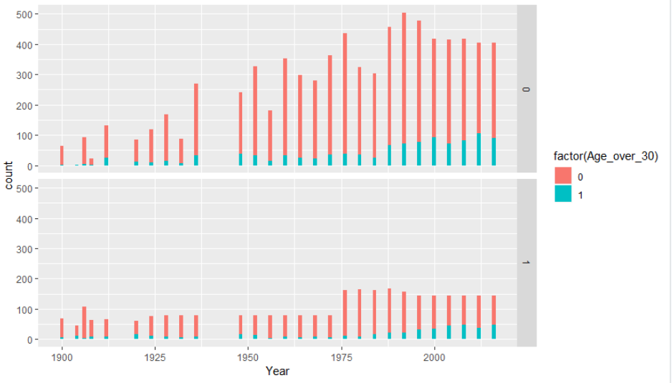
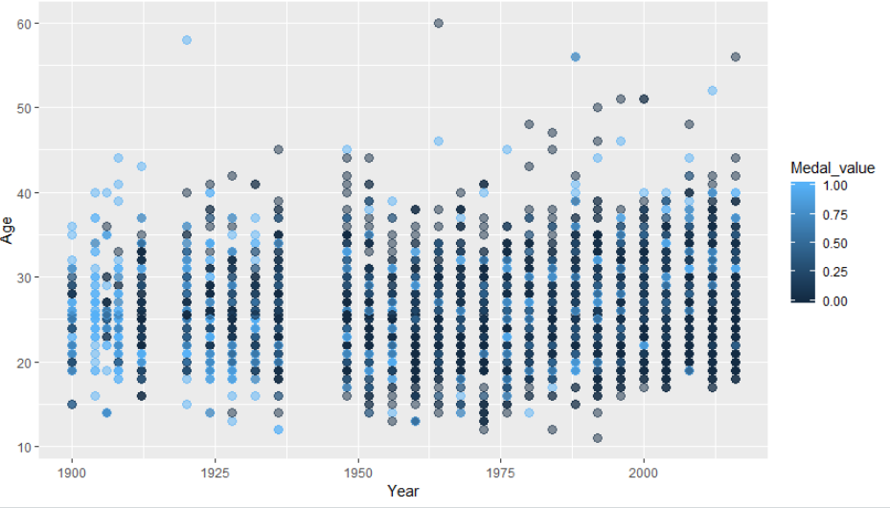
Rowing plots
Over 30 = 1
Earning a medal = 1
Evaluating the linear regression and R squared for Rowing, again using variable to Age over 30 and adding to the dependent variable NOC and Age the R squared resulted in 51.9%.

Slide 11
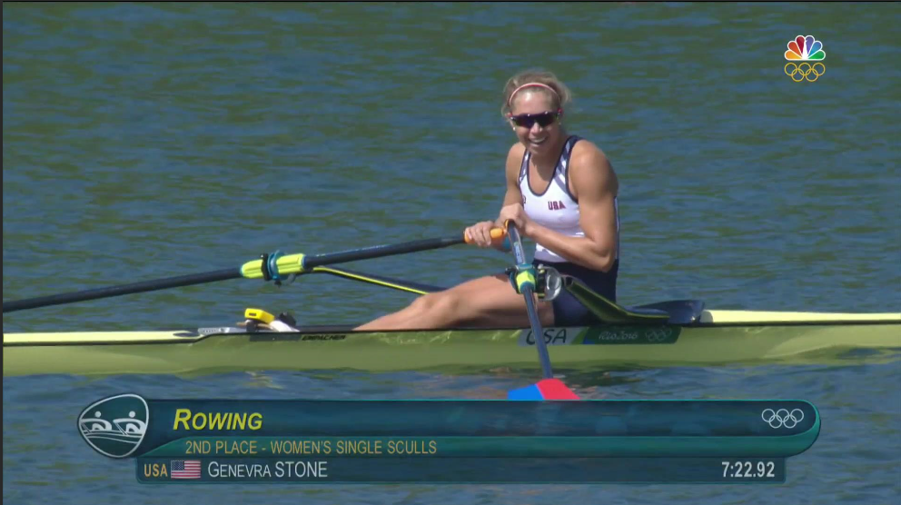
After review of these results in both the Training and Test dataset, the graphs show the average age increasing in these Sport specific, Equestrianism and Rowing and there will continue to be an upward trend of older athletes, however it is difficult to predict if they will be successful in earning a medal.
However in consideration of the marketing to this athlete age group, as long as the current percentages continue to earn the medals, it will support the target market. The focus here should be to attract these athletes participating in these sports to use and promote your apparel and shoes. Focus on reaching out to the competitive groups in these sports reflecting those recent athletes that have been successful at the Olympic games in their Sport even if
they are above the mean age for the sport.
Collaborate with them on what are their
needs to succeed in their
sport. And most importantly remember
your target customer is not just these
specific Olympic athletes, but all that
aspire to perform as they do, like Genevra
Stone.

Slide 12
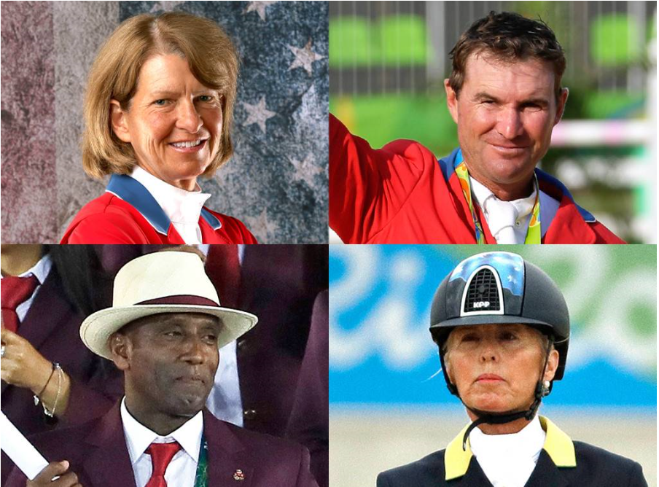
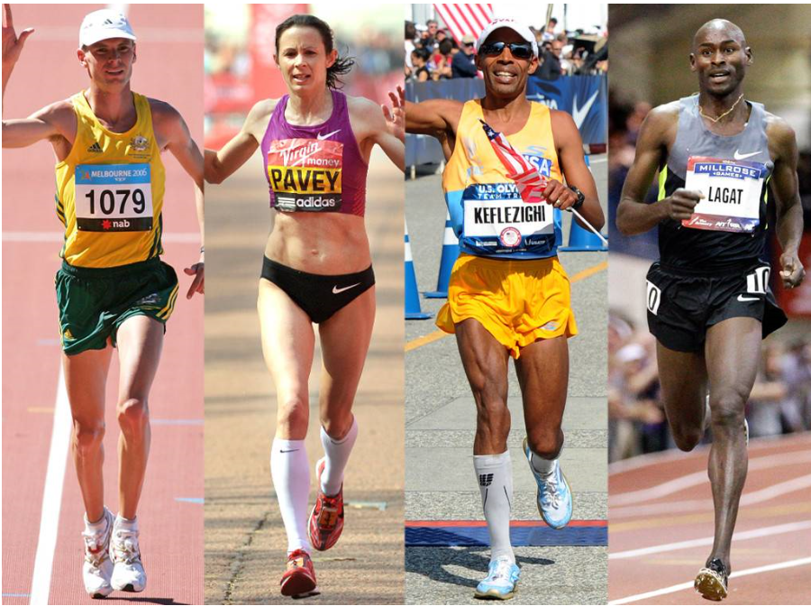
I hope these results can show Sports companies that focusing on all age groups is important. This research and predicting trends could continue focusing on NOC for which country teams have the highest chance of earning a medal over 30 to further focus your marketing. It could also be analysized for Sex, especially focusing on Sport to determine which market segment to focus product creation and market needs. While the percentage of athletes earning a medal or even participating in an Olympic event over the age of 30 will always be in the minority, highlighting these achievements in your marketing can motivate your target market to aspire to be like them and the products used to get them there.

